Slide 1
Analyzing the Clinical and Financial Data of Patients

Slide 2
Data Collection
Collected data from Demographics, Bill ID, Bill Amount and Clinical Data.
Based on Patient ID,
The Demographics info of the patient added in Clinical Data.
With Bill reference ID,
Total sum of amount paid per date is calculated.
The Total amount is added to the clinical data.
3400 data is generated from all the datasets.
Finally, 3000 data is identified after removing the previous date of admission.

Slide 3
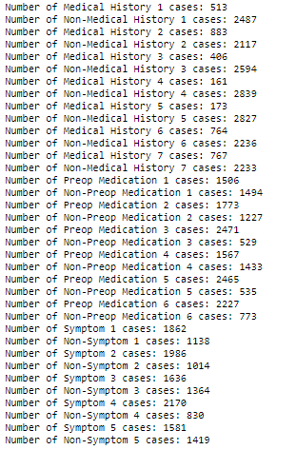
Python coding
The NLTK WordNetLemmatizer analyzes the occurrences of medical history, preop medication and symptoms of the patients
It is found that symptom 4, medical history 2 and Preop medication 3 is highly prevalent.

Slide 4
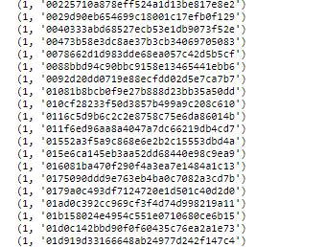
Python coding
Collect Patient ID in text file -> to find the occurrences of individual IDs using the dictionary function.
The patient ID 4e46fddfa404b306809c350aecbf0f6a is frequently admitted

Slide 5



Python coding
The occurrences of the race, gender and resident status with unique id is calculated.
The Male, Chinese and Singaporeans are found to be highly frequent.

Slide 6
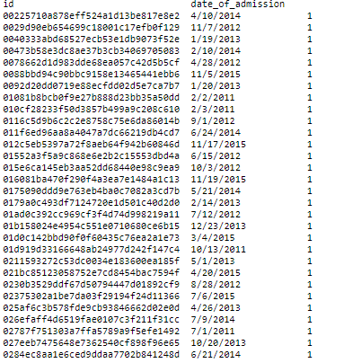
Python coding
The size of id with different date of admission is known

Slide 7
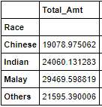
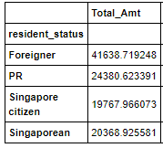
Python coding
The mean value for all columns with unique resident status is calculated.
It is known that the total amount paid by the foreigners and Malay people is quite high

Slide 8
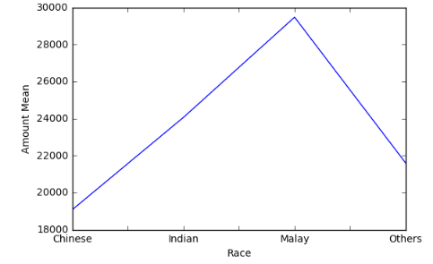
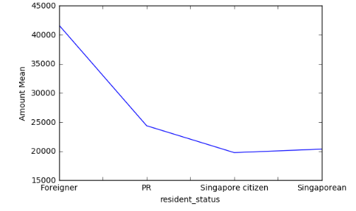
Python coding
Graph is plotted among the race and amount mean, resident status and amount mean

Slide 9



Python coding
The mean value for the lab result 1, lab result 2 and lab result 3 with unique gender is obtained
The female have the highest mean in all lab results 1,2 and 3

Slide 10
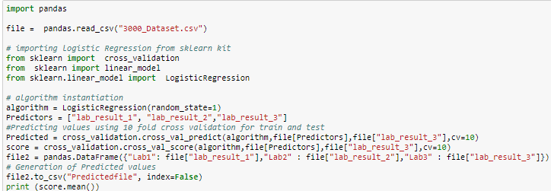
Python coding
Lab result 1,2 and 3 values are predicted using
cross validation of 10 folds
linear model logistic regression

Slide 11
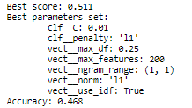
Python coding
With the new column as label, the grid search algorithm calculates the accuracy value of the table

Slide 12
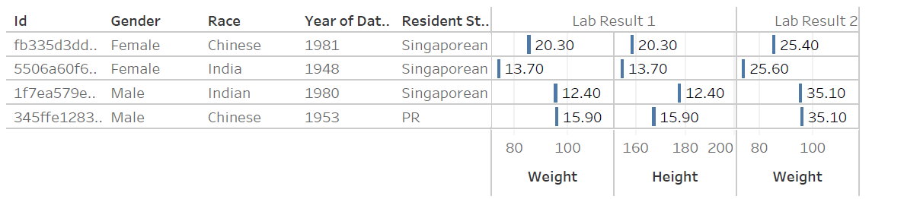
Tableau Visualization
1f7ea579e5b21119194541db0cc9f6d2 is having the highest aggregate value in lab result 1,2 and 3

Slide 13
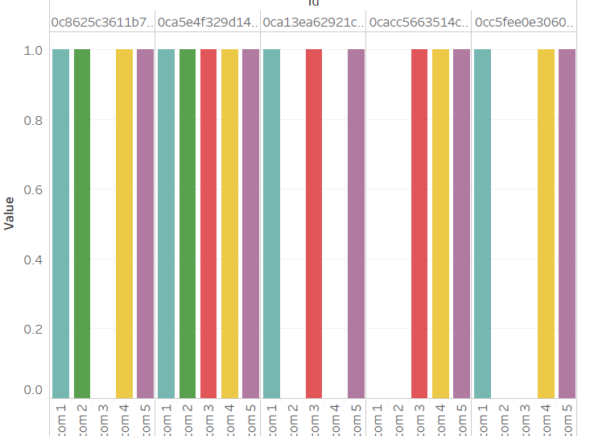
Tableau Visualization
Patient ID with any or all the Symptoms 1,2,3,4 and 5 is easily visualized through the bar chart form

Slide 14
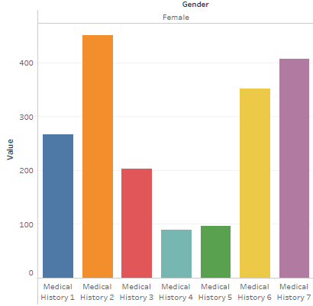
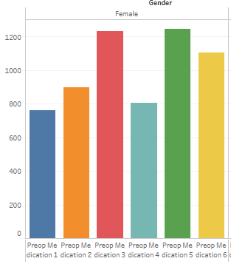
Tableau Visualization
Medical history and Preop medication prevalence in male or female is visualized

Slide 15
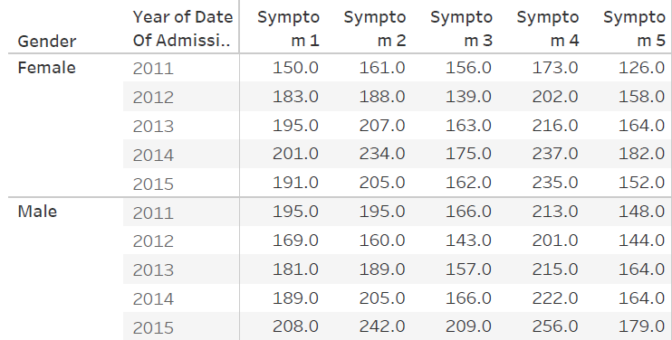
Tableau Visualization
The count frequency of Symptoms with year of admission and gender is validated.
The symptom 4 is common with both Male and Female.

